Slide 1
DevOps

Slide 2
✓
Looping
Outline
What is DevOps?
DevOps Importance and Benefits
DevOps Principles and Practices
7 C’s of DevOps Lifecycle for Business Agility
DevOps and Continuous Testing
How to Choose Right DevOps Tools
Challenges with DevOps Implementation
Must Do Things for DevOps
Mapping My App to DevOps –Assessment
Definition, Implementation, Measure and Feedback

Slide 3
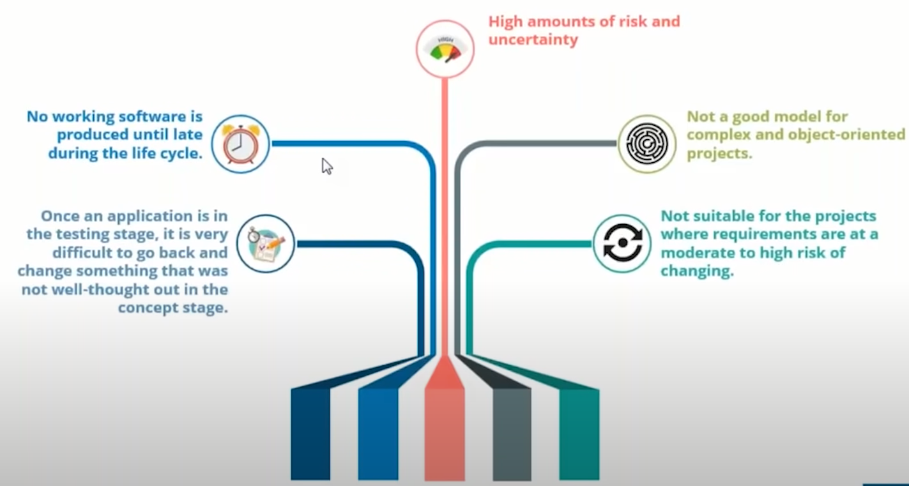
Limitation of Waterfall

Slide 4
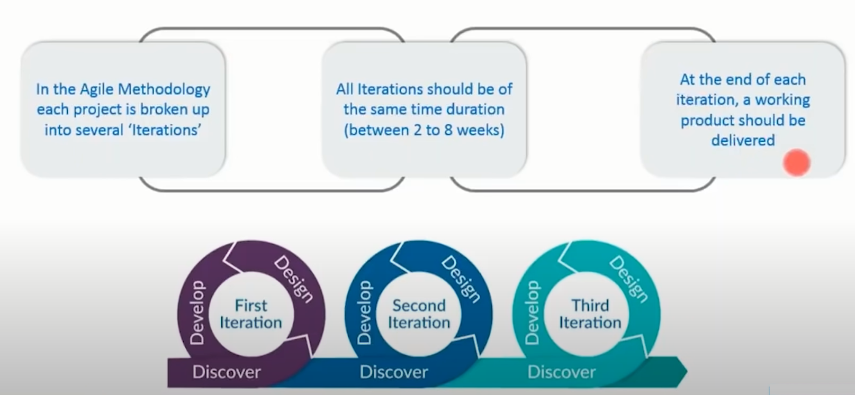
Agile Model

Slide 5
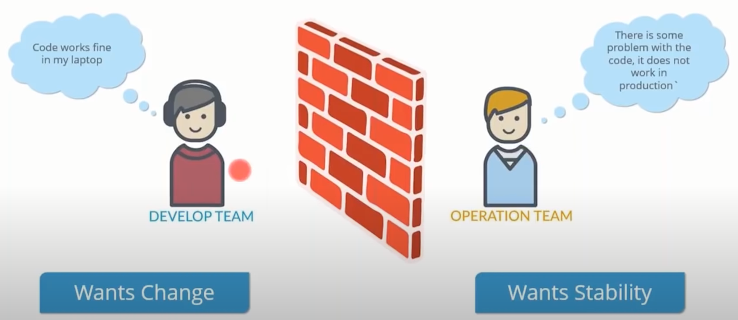
Limitation of Agile

Slide 6
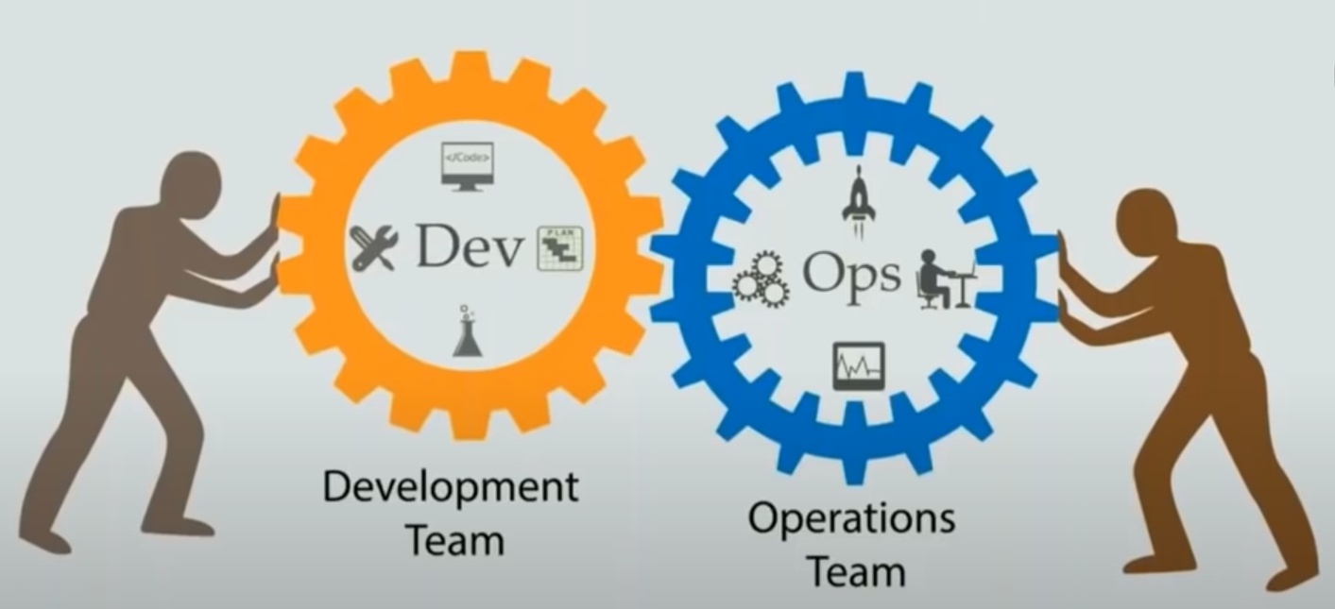
Solution is DevOps

Slide 7
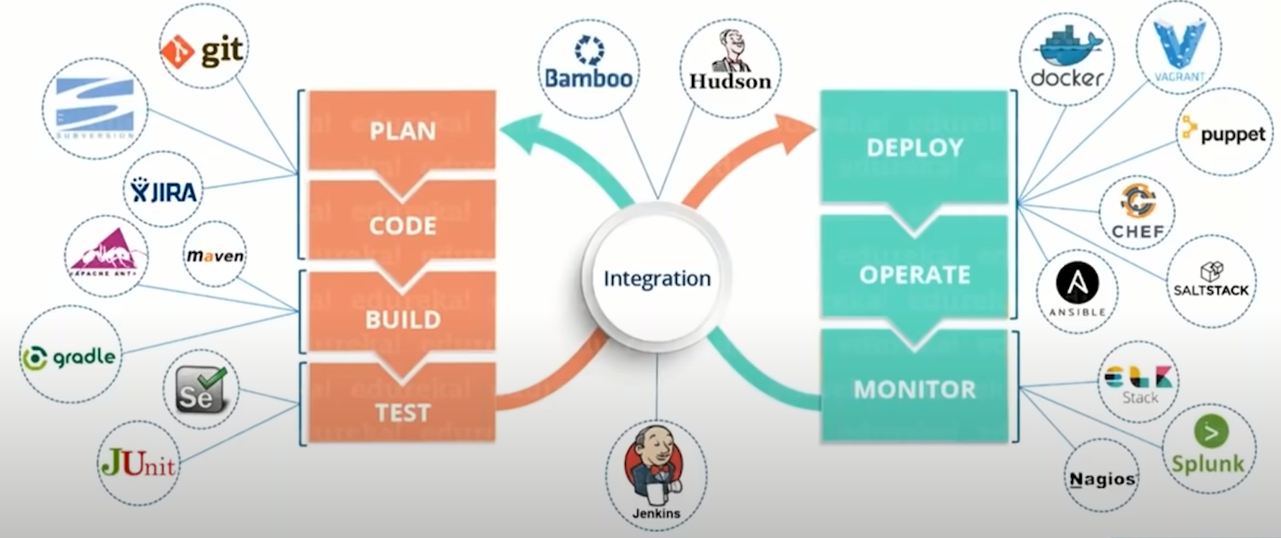
What is DevOps?

Slide 8
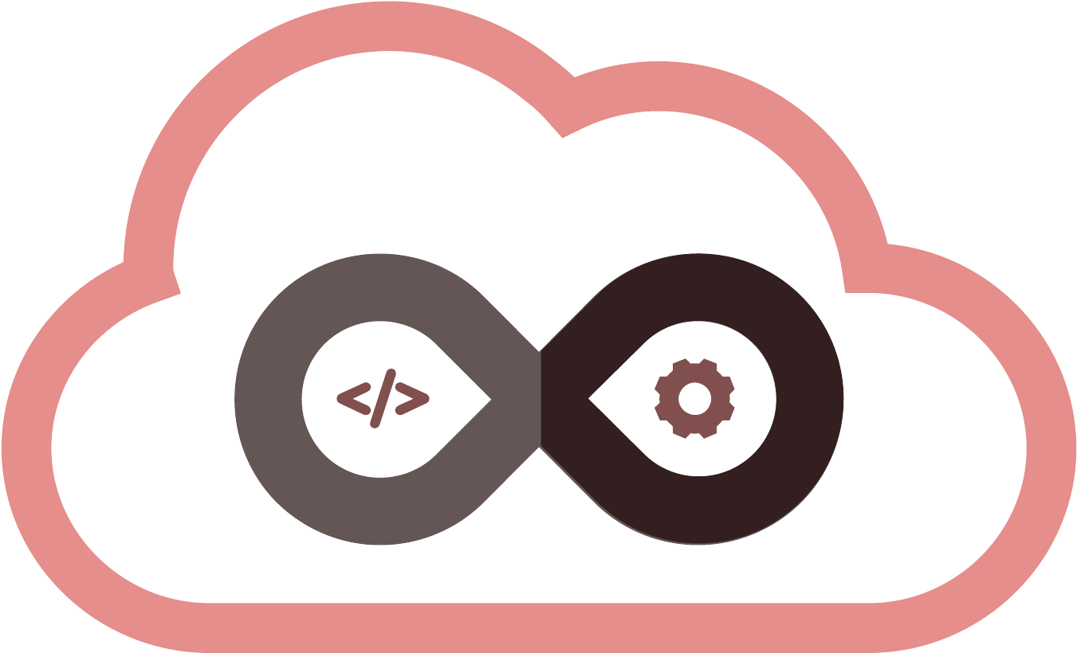
What is DevOps?
The word DevOps is the mixture of two words Dev (it represents Software Development) and Ops (It represents IT Operations e.g. Application and infrastructure planning, Automation implementation, incident response, and incident management, etc.)
DevOps is a group of practices & principals that perfectly blends software development (Dev) and IT operations (Ops).
The main aim of DevOps is to provide continuous & high-quality delivery of the software by making shortening SDLC (Software Development Life Cycle)
DevOps bridges the gap between the operation team & development team, which generally used to work in isolation with another.
Plan
Code
Build
Test
Development
DevOps
Operations
Release
Deploy
Operate
Monitor

Slide 9
DevOps Importance and Benefits
1
Technical benefits
3
Business benefits
Continuous software delivery
Faster delivery of features
Less complexity to manage
More stable operating environments
Faster resolution of problems
Improved communication and collaboration
Maximizes Efficiency with Automation
More time to innovate (rather than fix/maintain)
Optimizes the Entire Business
2
Cultural benefits
Gets the focus on What Matters Most: People
Happier, more productive teams
Higher employee engagement
Greater professional development opportunities

Slide 10
DevOp Practices
DevOps Principles
Process automation
Continuous Integration (CI)
Continuous Delivery (CD)
Continuous Deployment
Infrastructure as code
Microservices
Configuration management and many more.
DevOps principles guide how to organize a DevOps environment.
Incremental Releases
Automation
DevOps Pipeline
Continuous Integration
Continuous Delivery
Continuous Monitoring
Feedback Sharing
Version Control
Collaboration

Slide 11
7 C’s of DevOps Lifecycle for Business Agility
An agile relationship between development & operations are defined by DevOps.
DevOps is a set of rules and procedures followed by the development team and operational engineers together from beginning to the final stage of the product.
To understand the DevOps lifecycle phases is essentials to Learn DevOps.
The DevOps Life cycle is described by 7’C
The 7’C approach to DevOps requires an efficient integration of processes and tools to automate the seamless information exchange and execution.
The 7’C approach to DevOps also requires efficient collaboration between all stakeholders empowering them to contribute more.
The 7’C approach removes all deviation of information and execution.

Slide 12
7 C’s of DevOps Lifecycle for Business Agility
Continuous Development
Continuous Integration
Continuous Testing
Continuous Monitoring
Continuous Feedback
Continuous Deployment
Continuous Operations

Slide 13
7 C’s of DevOps Lifecycle for Business Agility Cont.
1
Continuous Development
2
Continuous Integration
Planning and Coding of the software are involved in this initial phase.
During the planning phase, the vision of the project and scope is decided.
After the planning, developers used to begin coding the application.
For the planning no DevOps tools available, but many tools available to maintain the code.
This is the main stage of the DevOps lifecycle.
Developers should commit the changes to the source code more frequently as a software development practice. This should be on daily and weekly basis.
Next step is to build the every commit, this is used for early detection of problems if they are present. Building the code involves not the compilation, but also includes unit testing, integration testing, code review, and packaging.
The new functionality is continuously integrated with the existing code. So, there is continuous development of software. The newly written code needs to be integrated continuously and smoothly with the systems to reflect changes to the end-users.
Jenkins is a famous tool used for continuous integration. Once the change in the Git repository is ready, then Jenkins fetches the committed code and prepares a build of that code. Then this build is given to the test server or the production server.

Slide 14
7 C’s of DevOps Lifecycle for Business Agility Cont.
3
Continuous Testing
4
Continuous Monitoring
In this phase, software continuously testing for bugs. The tools like TestNG, JUnit, Selenium etc are used for the constant testing.
This phase, where the developed software is continuously testing for bugs. For constant testing, automation testing tools such as TestNG, JUnit, Selenium, etc are used.
These testing tools allow QAs to test multiple code-bases in parallel to ensure that there is no flaw in the functionality. Docker Containers can be used for simulating the test environment.
Replacing manually testing to Automation testing saves a lot of time and effort for executing the tests. The code is continuously integrated with the existing code, after the testing.
Monitoring is the phase where important information about the use of software is recorded and processed to identify the problem areas. Monitoring is integrated with the operational capabilities of the software application. The system errors such as server not reachable, low memory, etc are resolved in this phase. It maintains the security and availability of the service.

Slide 15
7 C’s of DevOps Lifecycle for Business Agility Cont.
5
Continuous Feedback
7
Continuous Operations
By analyzing the results from the operations of the software, one can improve the application development.
This can be achieved by constant feedback among the development and the operations of the next version of the current software applications.
All the operations in DevOps are based on the continuity with complete automation of the release process. It allow the organization to accelerate the overall time to market.
It is clear that continuity is the critical factor in the DevOps in removing steps that often distract the development, take it longer to detect issues and produce a better version of the product after several months. With DevOps, we can make any software product more efficient and increase the overall count of interested customers in your product.
6
Continuous Deployment
This phase deploys the code to the production servers.
This is essential to ensure that the code is correctly working on the production servers and real environments. The new code should be deployed continuously.
The new code is deployed continuously, and configuration management tools play an essential role in executing tasks frequently and quickly. Here are some popular tools which are used in this phase, such as Chef, Puppet, Ansible, and SaltStack.

Slide 16
DevOps and Continuous Testing
In DevOps Continuous testing is the most important process of the continuous delivery pipeline along with Continuous Integration in the same pipeline.
The continuous testing in DevOps contains the execution of automated tests repeatedly & continuously against the codebase in the various deployment environments.
Continuous testing contains unit tests, static code analysis, security code analysis, integration tests & load and performance tests. These sets of tests run in an automated continuous testing pipeline.
To test every line of code, every time at different stages is almost impossible to do each time manually when a line of code is updated into version control. That’s where continuous testing comes into the picture.

Slide 17
DevOps and Continuous Testing Cont.
Continuous Delivery (CD) | Automated Deployment Pipeline
Continuous Integration Build Pipeline
Code
Check In
Compile & Build
Automated Unit Test
Acceptance Test
User Acceptance Test
Release to Production
Automatic Approval Quality Gate
Manual Approval Quality Gate
Continuous Testing – Test Pipeline

Slide 18
DevOps and Continuous Testing Cont.
AAQG = Automated Approval Quality Gate
Continuous Testing (CT)
Integration Environment
System Testing Environment
On CI Server
Unit Tests, Security Tests
AAQG
Integration Tests
AAQG
System Tests & Non Functional Test
Code
AAQG
AAQG
Manual Gate
Performance & Load Test
Acceptance Test, Exploratory Test
End User Acceptance Test
Release to Production
Performance Testing Environment
Production Like Environment
Pre Production Environment
Notes:
https://www.softwaretestinghelp.com/continuous-testing-in-devops/

Slide 19
DevOps and Continuous Testing (CT) Cont.
As per the continuous testing (CT) diagram, unit tests are carried out on the CI server. It tests each unit of the system in an isolation.
Integration tests are carried out on the Integration environment to verify the components integrated.
System tests are carried out in the system testing environment where the system the integrated components and interfaces are tested through system-level scenarios in a system testing environment.
CT progressively becomes harder and longer with the progression towards the production environment as environment complexity advances.
The test cases are required to update each time at different phases. The automated scripts required to update because the code becomes more mature & progresses to a higher level of environment ill it gets into production.
The time to execute the tests increases with the testing progress. E.g. the unit test may take very little time to execute, the integration tests, system tests or load tests may take a few hours to execute or may take a few days for execution.
The CT mainly running the automated test cases. It also involves certain manual tests and approval gates, where few tests are executed manually, before pushing into the production.

Slide 20
Benefits of Continuous Testing in DevOps
Early identification of critical bugs
Smooth collaboration among developers, QA and Operations team
At each stage of SDLC, it helps to assess the quality of software developed
Leads to improvement in code quality by driving faster test results which
Repeated testing ensures minimal failure rate for new releases
Faster time to market with a viable product and continuous feedback mechanism

Slide 21
Choose Right DevOps Tools
At the time of adopting a DevOps approach for building and operating software systems, one should rely on modern tools for each & every aspect of build, release, and operations activities.
The first step to choose Right DevOps Tools is one need to think more broadly about what company need.
Following are the guideline for selecting the right DevOps tools for any organization
Select tools which facilitate collaboration
One should give proper importance to collaboration as a key selection aspect of tools.
Verify the main purpose of the tool to find collaboration opportunities.
Check, “How does the use of selected tool helps in collaboration?”
Select DevOps tools which provides APIs
The company can get mixture of new capabilities from multiple API-driven tools.

Slide 22
Choose Right DevOps Tools Cont.
Select the tools which can store configuration in version control
Select tools that provides configuration to version control system available in market.
DevOps tools should encourages learning
Few tools for DevOps are so much involved and complicated for the people new to them; one should not expect everyone to understand or adopt complex new tools immediately. If management selects a tool that is too tricky to use, some people may start opposing, especially if management don't provide training.
Company should select tools which is easy to use.
Bring people with company into the DevOps journey.
Avoid special production-only tools
Select tool that enhance inter-team communications
Consider the entire organization as a system you are building.
Select separate tools for the separate teams.
One should deploy shared tools for the collaborative teams.

Slide 23
Challenges with DevOps Implementation
Lack of a Standard Definition for DevOps
Many companies are still not have the actual understanding of DevOps e.g. the purpose behind it, or for that matter, the benefits of using it.
Many people believe that DevOps overrules existing methodologies like Scrum which are practiced in most industries.
Actually, DevOps helps to improve the execution of available methodologies.
The implementation of DevOps becomes risky because of the lack of proper understanding.
Lack of Vision
It is difficult to have a vision without proper understanding and definition of the problem or solution. Because of it analysts may stuck to ambiguous circle.
It is really more difficult to break this ambiguous circle & to become more receptive to the newer methods like DevOps for betterment – all at the same time!
Shortage of Tool Knowledge
Choice of Tools
Lack of Tool Integration
Cultural Challenges
Isolated Teams
Risk Analysis
Notes:
https://dzone.com/articles/overcoming-the-challenges-of-devops-implementation

